Slide 1
Imperative programming in Scratch
Jon Sporring
Department of Computer Science
2020/05/18

Slide 2
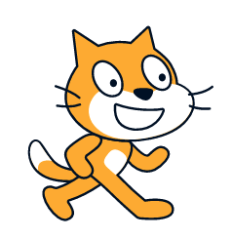
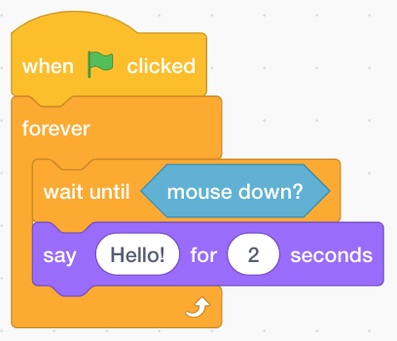
0. Content of this video
Imperative programming
Introduction to Scratch
Scratch programs:
Hello world
React to the mouse
Count to 9

Slide 3
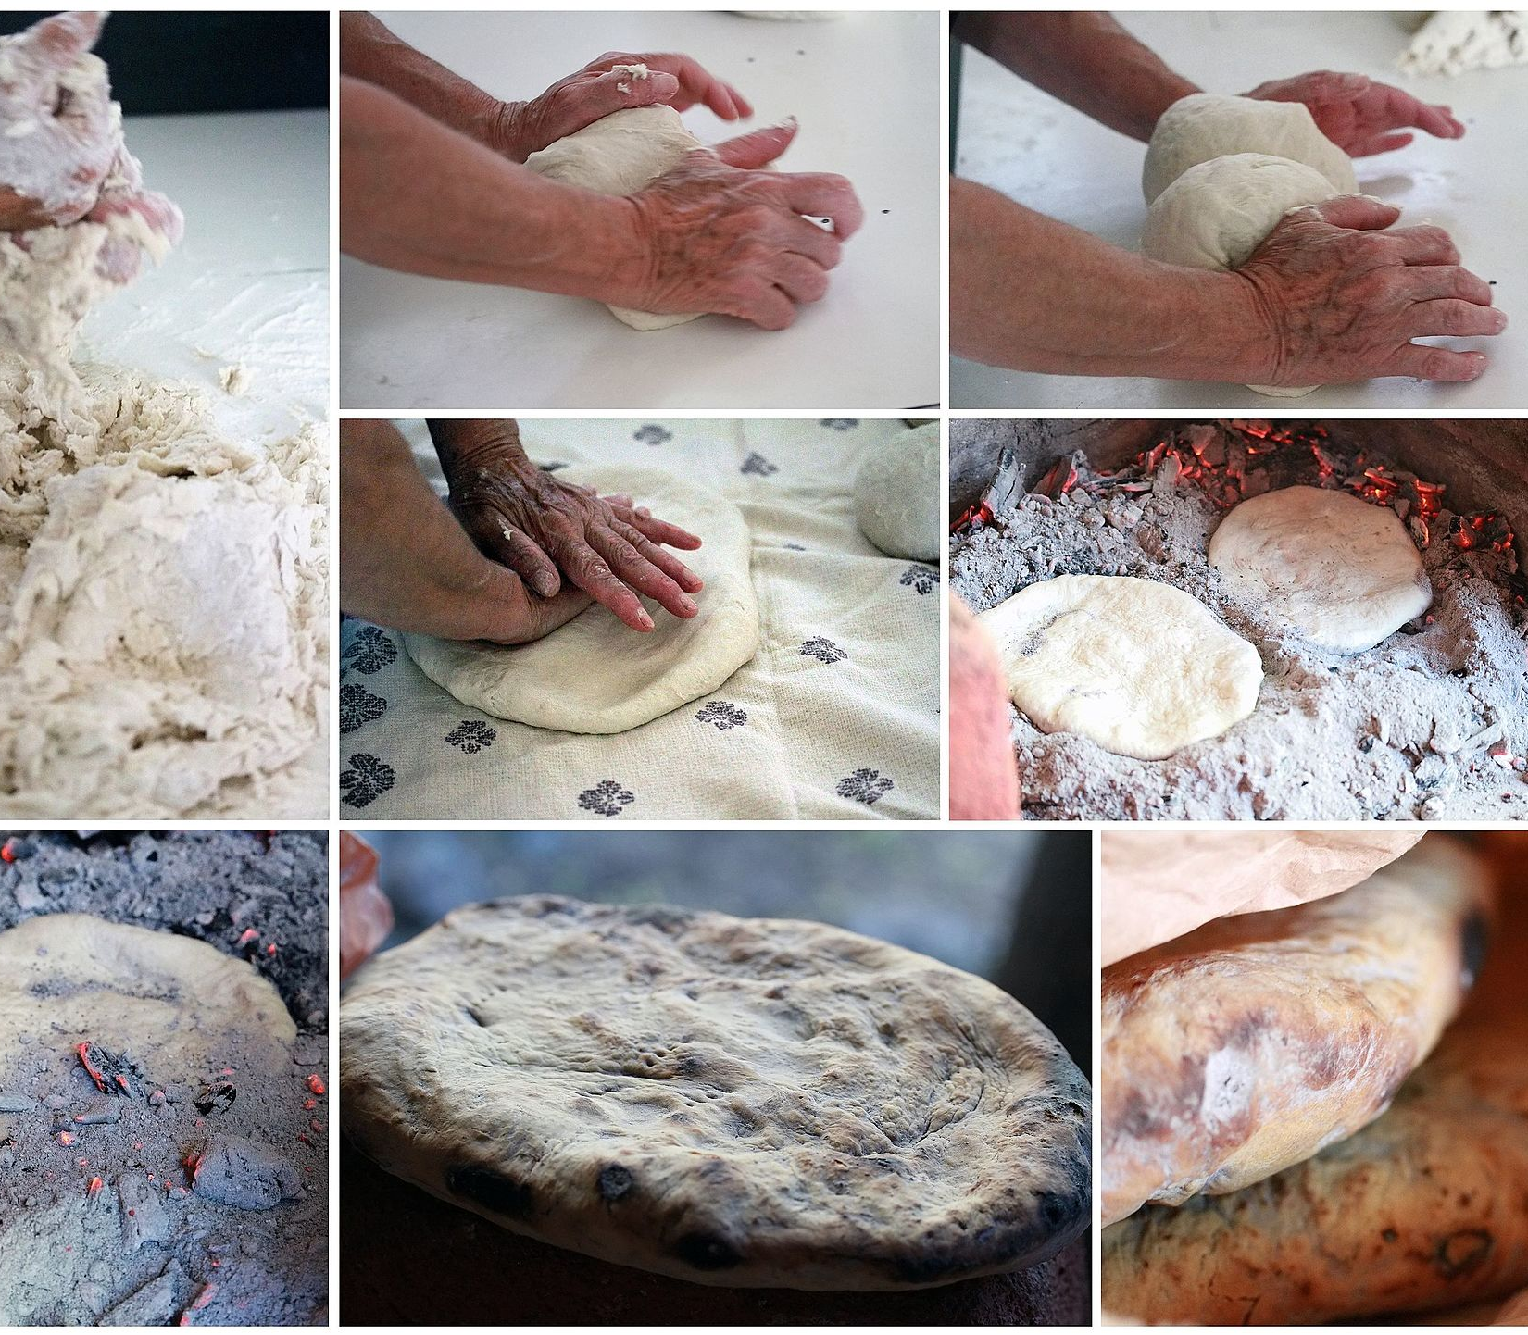
1. Imperative programming
Ingredients:
50 g yeast
600 ml lukewarm water
Approx. 1 kg wheat flour
1 tsp salt
2 tbsp oil
Directions:
Dissolve the yeast in the water in a bowl.
Add salt and oil.
Slowly add most of the flour until the dough is wet to touch but does not stick to the bowl.
Knead the dough thoroughly with more flour on the table.
Return the dough to the bowl, cover with a clean cloth, and let it rise to double size, typically 30 minutes.
Collapse the dough by punching it a couple of times, divide it into 16 buns, and place them on baking paper on a sheet pan.
Cover and let it rise again to double size, typically 30 minutes
Bake at 200° Celsius for approx. 25 minutes

Slide 4
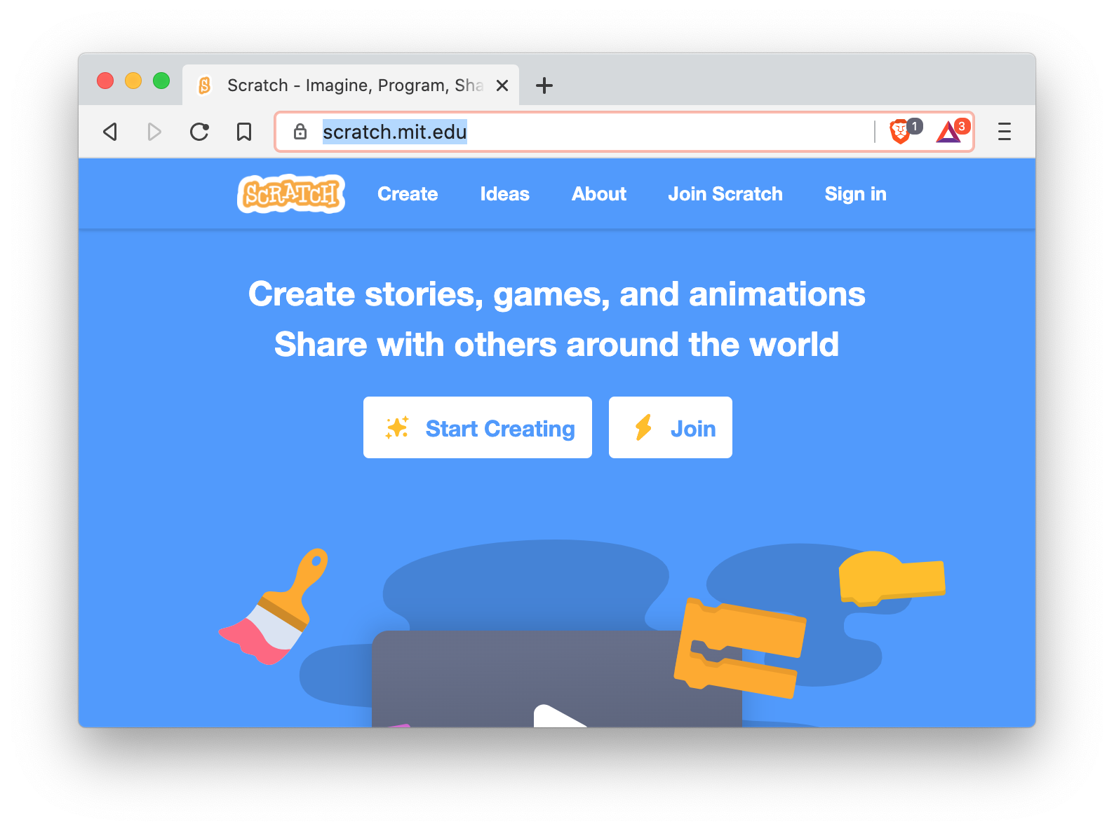
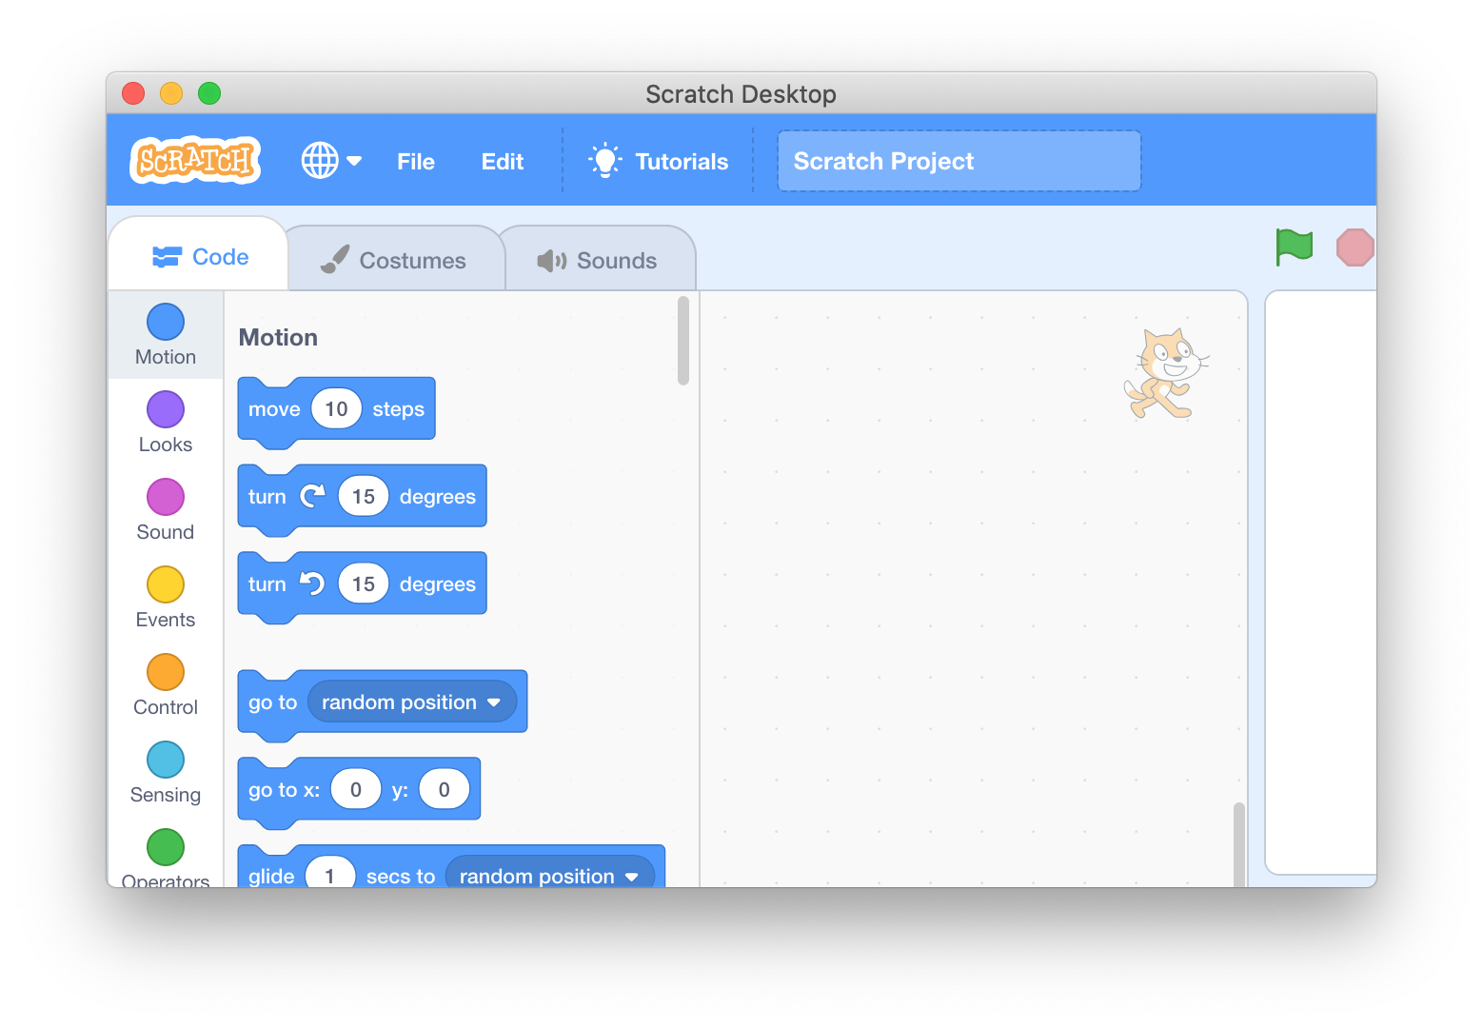
2. Introduction to Scratch
Web version: https://scratch.mit.edu/
Style: Block-based visual programming language
Target: primarily at children
History: First version in 2003 by the MIT Media Lab's Lifelong Kindergarten group together with Playful Invention Company in Montreal.
Desktop version

Slide 5
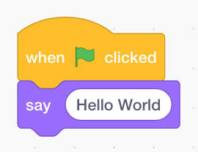
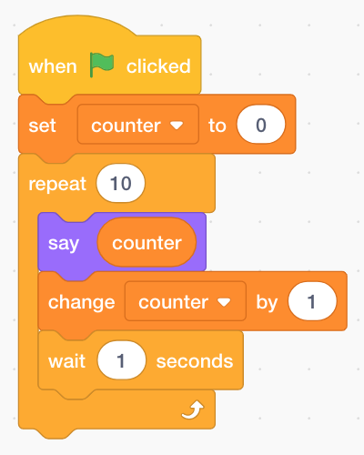
3. Scratch programs
Hello World
Description: Print “Hello World” to the screen
React to the mouse
Say “Hello” every time the left mouse button is pressed.
Count 0 to 9
Print the numbers 0 to 9 to the screen

Slide 6
Summary
Imperative programming is like a cooking recipes
Scratch follows the imperative programming paradigm
You have seen the Scratch blocks for:
Output (say)
Loops (forever and repeat)
Conditions (wait until)
Input (when and mouse down)
Variables (counter)
Assignments (set)
Expressions (change)
Parameters

